Slide 1


MOBILE APPLICATION DEVELOPMENT
JavaScript
Classes

Slide 2
JavaScript
Class-based object-oriented languages, such as Java, C++, C#, are founded on the concept of two distinct entities: classes and instances
JavaScript is an object-based language based on prototypes, rather than being class-based

Slide 3
Defining a Class
In class-based languages, you define a class in a separate class definition.
Definition contains Constructors, Instance variables, methods/members
Create an object using new operator
JavaScript follows a similar model, but does not have a class definition separate from the constructor
Instead, you define a constructor function to create objects with a particular initial set of properties and values
Any JavaScript function can be used as a constructor
You use the new operator with a constructor function to create a new object.

Slide 4
Defining a Class
Class-Based
Prototype-Based
public class Employee {
public String name = "";
public String dept = "general";
}
Employee eObj = new Employee();
Console.WriteLine(eObj.dept);
function Employee() {
this.name = '';
this.dept = 'general';
}
var eObj = new Employee();
console.log(eObj.dept);

Slide 5
MOBILE APPLICATION DEVELOPMENT
JavaScript
ES6 Classes

Slide 6
ES6 Classes
JavaScript classes, introduced in ECMAScript 2015, are primarily syntactical sugar over JavaScript's existing prototype-based inheritance
The class syntax does not introduce a new object-oriented inheritance model to JavaScript
Classes are in fact "special functions", and just as you can define function expressions and function declarations
Class syntax has two components:
class expressions
class declarations

Slide 7
Class Declarations
One way to define a class is using a class declaration. To declare a class, you use the class keyword
class Rectangle {
constructor(height, width) {
this.height = height;
this.width = width;
}
}

Slide 8
Hoisting (1/4)
Hoisting is JavaScript's default behavior of moving declarations to the top.
In JavaScript, a variable can be declared after it has been used.
In other words; a variable can be used before it has been declared.
x = 5;
var x;
console.log(x);
var x;
x = 5;
console.log(x); // 5
fName = "Ali"
lName = "Zafar"
var fName, lName
console.log(fName, lName);
var fName, lName
fName = "Ali"
lName = "Zafar"
console.log(fName, lName); // Ali Zafar

Slide 9
Hoisting (2/4)
Variables and constants declared with let or const are not hoisted!
x = 5
let x
console.log(x)
x = 5
const x
console.log(x)

Slide 10
Hoisting (3/4)
JavaScript only hoists declarations, not initializations.
only the declaration (var y), not the initialization (=7) is hoisted to the top.
var x = 5; // Initialize x
var y = 7; // Initialize y
console.log(x + y) // 12
var x = 5; // Initialize x
console.log(x + y) // NaN
var y = 7; // Initialize y
var x = 5; // Initialize x
var y; // Declare y
console.log(x + y); // NaN
y = 7; // Initialize y
var x = 5; // Initialize x
y = 7; // Initialize y
console.log(x + y); // 12
var y; // Declare y

Slide 11
Hoisting (4/4)
An important difference between function declarations and class declarations is that function declarations are hoisted and class declarations are not
var rect = new Rectangle();
class Rectangle { }
// ReferenceError
var sqr = new Square();
function Square() { }

Slide 12
Class Expression
A class expression is another way to define a class. Class expressions can be named or unnamed
// unnamed
let Rectangle = class {
constructor(height, width) {
this.height = height;
this.width = width;
}
};
console.log(Rectangle.name);
// output: "Rectangle"
// named
let Rectangle = class Rectangle2 {
constructor(height, width) {
this.height = height;
this.width = width;
}
};
console.log(Rectangle.name);
// output: "Rectangle2"

Slide 13
Constructor
The constructor method is a special method for creating and initializing an object created with a class
There can only be one special method with the name "constructor" in a class
A SyntaxError will be thrown if the class contains more than one occurrence of a constructor method.
A constructor can use the super keyword to call the constructor of the super class.

Slide 14
Getters, Methods
Get keyword is used for creating Getter
Getter is called as a property or field name instead of function
E.g. square.area and not square.area()
Whereas, Method are declared without function keyword and can be called as a function
E.g. square.calcArea()
class Rectangle {
constructor(height, width) {
this.height = height;
this.width = width;
}
// Getter
get area() {
return this.calcArea();
}
// Method
calcArea() {
return this.height * this.width;
}
}
const square = new Rectangle(10, 10);
console.log(square.area); // 100

Slide 15
Getters, Methods – Another Example
Height is a getter and used as rect.Height
setHeight is a setter and used as rect.Height(20)
class Rectangle {
constructor(height, width) {
this.height = height;
this.width = width;
}
get Height() {
return this.height;
}
setHeight(height) {
this.height = height;
}
}
var rect = new Rectangle(10, 15);
console.log(rect.Height); // 10
rect.setHeight(20);
console.log(rect.Height); // 20

Slide 16
Static Method
The static keyword defines a static method for a class
Static methods are called without instantiating their class and cannot be called through a class instance
Static methods are often used to create utility functions for an application.
class Point {
constructor(x, y) {
this.x = x;
this.y = y;
}
static distance(a, b) {
const dx = a.x - b.x;
const dy = a.y - b.y;
return Math.hypot(dx, dy);
}
}
const p1 = new Point(5, 5);
const p2 = new Point(10, 10);
p1.distance;
p2.distance;
console.log(Point.distance(p1, p2));

Slide 17
Private Field Declarations
class Rectangle {
#height = 0;
#width;
constructor(height, width) {
this.#height = height;
this.#width = width;
}
get Height() {
return this.#height;
}
setHeight(height) {
this.#height = height;
}
}
var rect = new Rectangle(10, 15);
console.log(`Height of Rectangle is ${rect.height} cm`)
console.log(rect.Height);
rect.setHeight(20);
console.log(rect.Height);
Notes:
Undefined
10
20

Slide 18
Inheritance
The extends keyword is used in class declarations or class expressions to create a class as a child of another class.
If there is a constructor present in the subclass, it needs to first call super() before using "this".
class Animal {
constructor(name) {
this.name = name;
}
speak() {
console.log(`${this.name} makes a noise.`);
}
}
class Dog extends Animal {
constructor(name) {
super(name); // call the super class constructor and pass in the name parameter
}
speak() {
console.log(`${this.name} barks.`);
}
}
let d = new Dog('Random dog');
d.speak(); // Random dog barks.

Slide 19

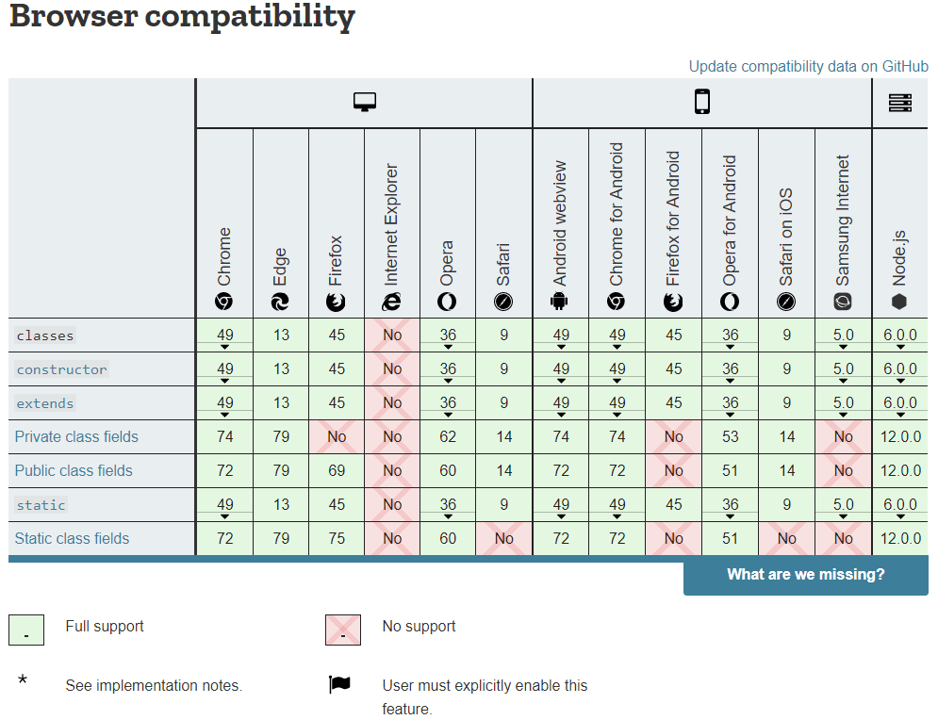

Slide 20
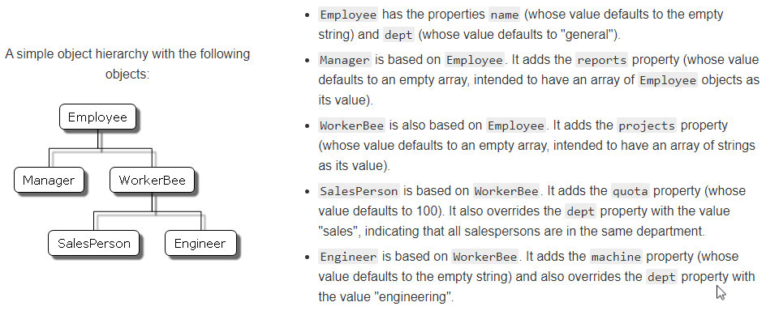
Exercise: Implement following scenario in ES6 Classes

Slide 21
References
MDN Web Docs: Details of the object model (https://developer.mozilla.org/en-US/docs/Web/JavaScript/Guide/Details_of_the_Object_Model)
MDN Web Docs: Classes (https://developer.mozilla.org/en-US/docs/Web/JavaScript/Reference/Classes)
W3Schools React ES6 (https://www.w3schools.com/react/react_es6.asp)

